Slide 1


IS669 BIG DATA & Information Systems
Group Project: Part 1
Airlines on Time Dataset

Slide 2
Project Members
Yuraja Kadari (U01866626)
Shreeya Desai (U01866812)
Umair Abdul Raheem (U01828366)
Vedant Mandre (U01850350)

Slide 3

Yuraja Kadari -
Year Assigned 1998
Agenda:
Cluster Creation
Data Extracting
Table Creation
Data Loading
Data Insights using SQL
Data Insights using Python
Data Insights using Tableau

Slide 4
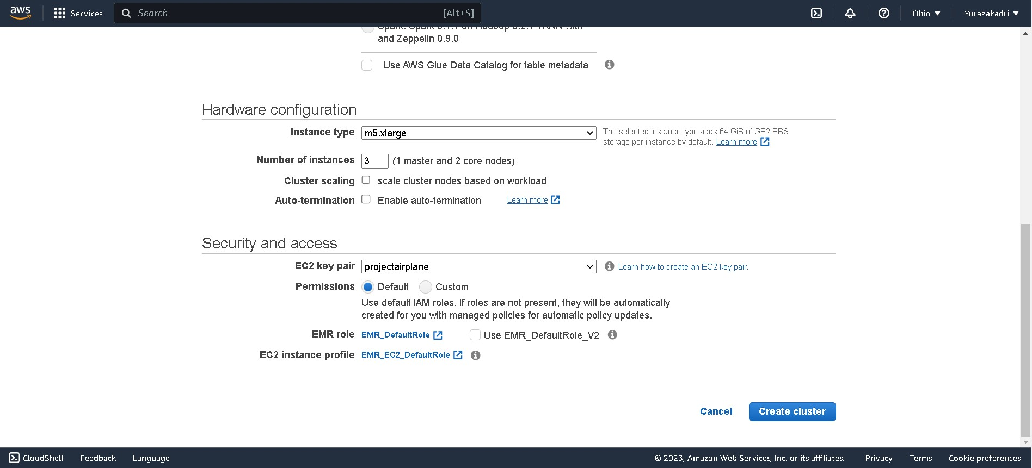
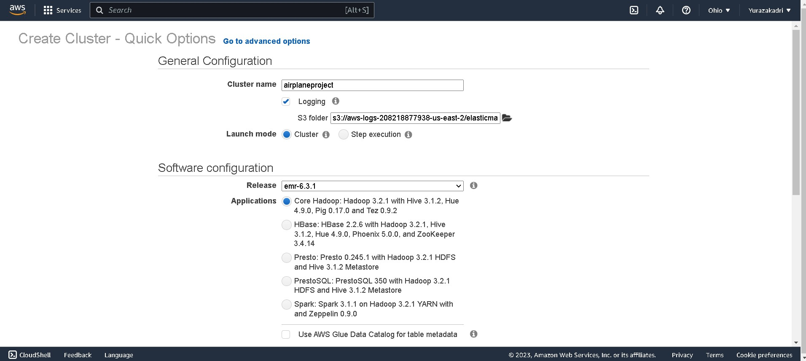
Creation of cluster
Yuraja Kadari -Year Assigned 1998
Steps for creating EC2-Cluster
Launch an EC2 instance.
Create an Amazon Machine Image (AMI).
Launch multiple instances using the AMI.
Configure the instances as a cluster using a tool like Apache Hadoop, Apache Spark or Kubernetes.
Set up load balancing and auto-scaling using AWS Elastic Load Balancing and AWS Auto Scaling.

Slide 5
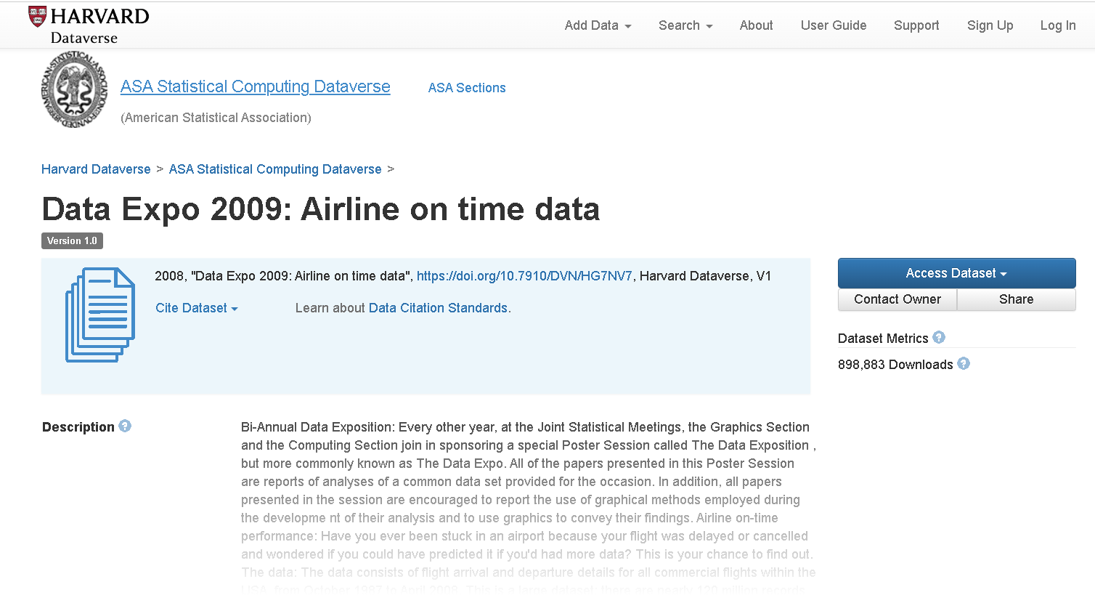
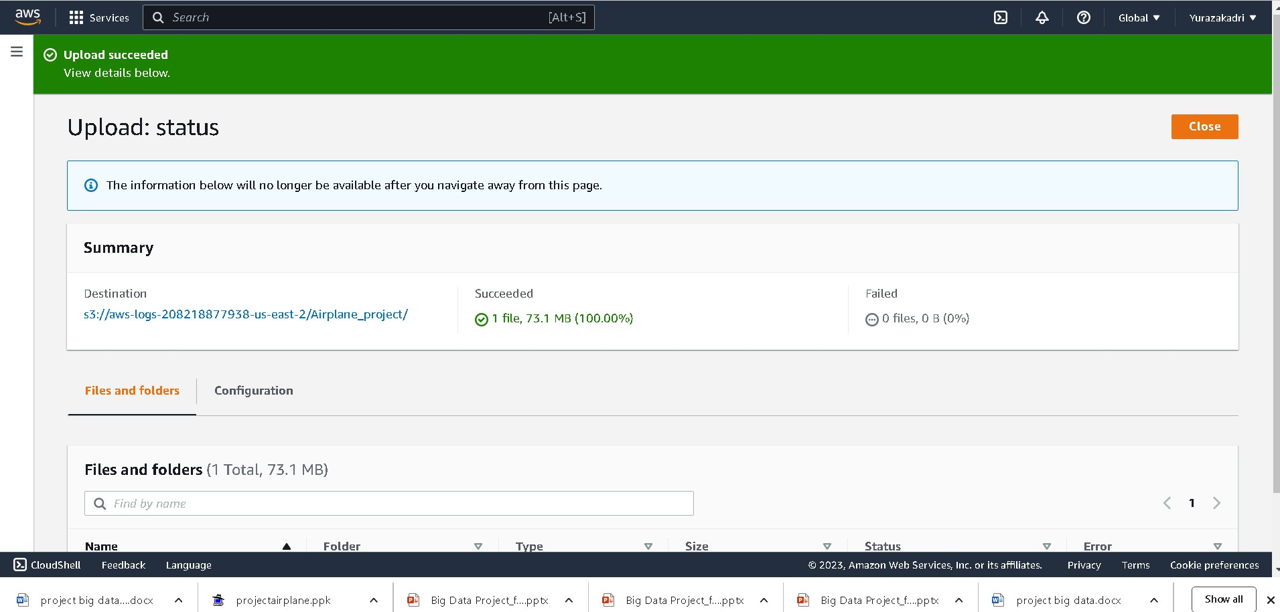
UPLOAD DATA IN AWS S3 BUCKET
Yuraja Kadari -Year Assigned 1998​
Steps for Data Extraction:
Downloaded the Dataset from Dataverse.hardvard.edu
Explore the Data Set using tool like Excel.
Open the AWS Management Console, navigate to the S3 service, and create a new bucket.
From the bucket's dashboard, select "Upload" to upload the dataset files from your local machine to the bucket.
Alternatively, you can use the AWS CLI or SDKs/APIs to upload the files to the S3 bucket.

Slide 6
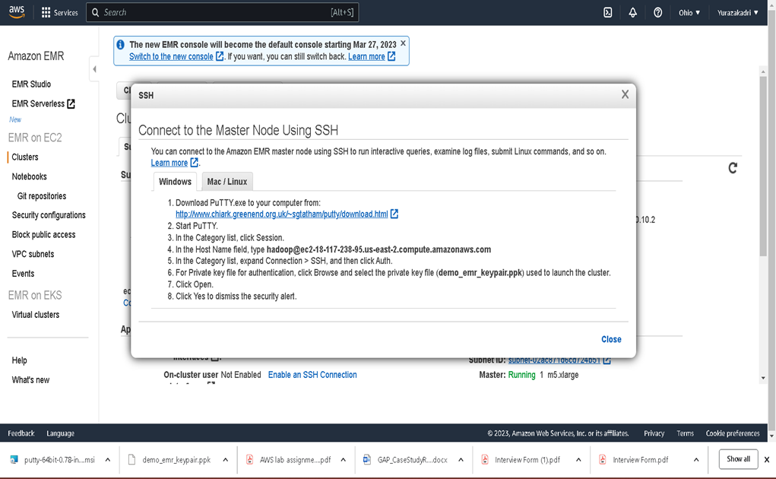
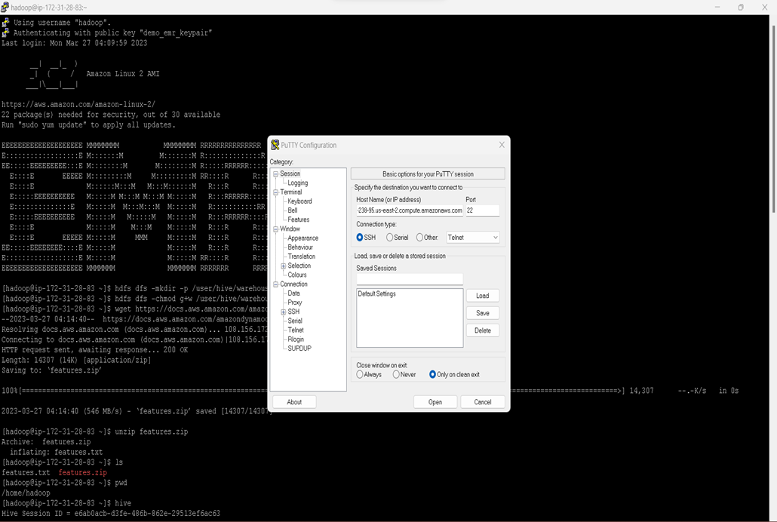
Load EMR using putty
Yuraja Kadari -Year Assigned 1998​​
Download and install PuTTY on your local machine.
Obtain the public DNS of your EMR master node from the EMR console.
Open PuTTY and enter the DNS in the "Host Name" field, select "SSH" as the connection type, and enter "22" as the port.
In the "Connection" -> "SSH" -> "Auth" section, select the private key file (.pkf) for the EMR cluster.
Click "Open" to establish an SSH connection with the EMR cluster.

Slide 7
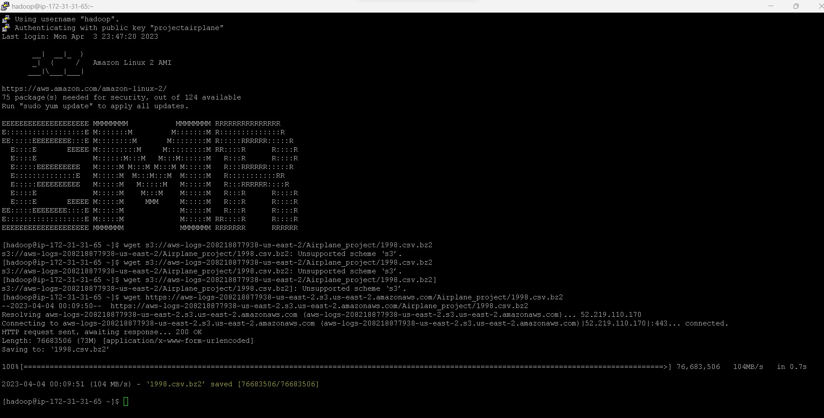
WGET COMMAND
Yuraja Kadari -Year Assigned 1998​​
Steps for loading data into Hadoop ENV:
Here we are using WGET command for fetching our 1998.csv file from s3 to our Hadoop Environment.
Creating directory name as YURAZA.
Putting file 1998.csv to that directory.
Establishing Hive environment using Hive command

Slide 8
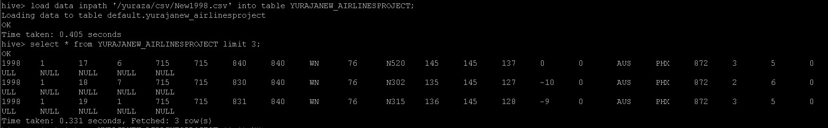
LOAD AND DISPLAY TABLE
Yuraja Kadari -Year Assigned 1998​​
Table Creation: CREATE EXTERNAL TABLE IF NOT EXISTS YURAZANEW_AIRLINESPROJECT (Year INT, Month INT, DayofMonth INT, DayOfWeek INT, DepTime INT, CRSDepTime INT, ArrTime INT, CRSArrTime INT, UniqueCarrier STRING, FlightNum INT, TailNum STRING, ActualElapsedTime INT, CRSElapsedTime INT, AirTime INT, ArrDelay INT, DepDelay INT, Origin STRING, Dest STRING, Distance INT, TaxiIn INT, TaxiOut INT, Cancelled INT, CancellationCode STRING, Diverted INT, CarrierDelay INT, WeatherDelay INT, NASDelay INT, SecurityDelay INT, LateAircraftDelay INT) ROW FORMAT DELIMITED FIELDS TERMINATED BY "," tblproperties("skip.header.line.count"="1");
Data Loading: load data inpath '/yuraza/csv/1998.csv' into table YURAZANEW_AIRLINESPROJECT ;

Slide 9
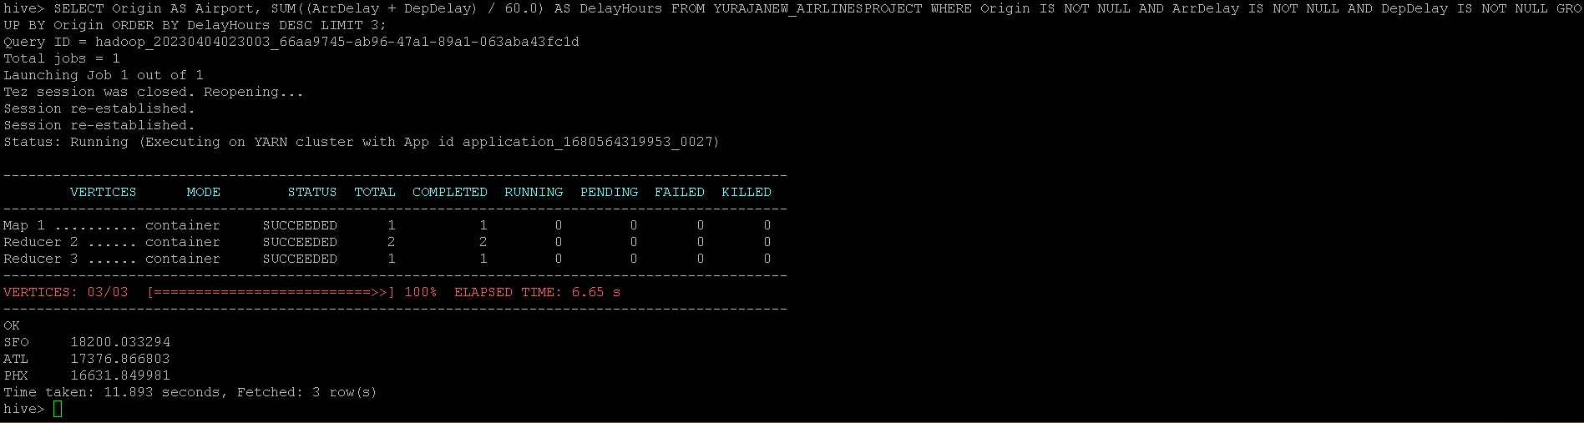
Yuraja Kadari -Year Assigned 1998​​
Query to determine the three airports with the highest delay time (in hours)
Query: SELECT Origin AS Airport, SUM((ArrDelay + DepDelay) / 60.0) AS DelayHours FROM YURAJANEW_AIRLINESPROJECT WHERE Origin IS NOT NULL AND ArrDelay IS NOT NULL AND DepDelay IS NOT NULL GROUP BY Origin ORDER BY DelayHours DESC LIMIT 3;
Query Explaination: The SQL query is selecting the "Origin" column from the "YURAJANEW_AIRLINESPROJECT" table and calculating the total delay time (in hours) by adding the "ArrDelay" and "DepDelay" columns for each airport. It then groups the results by the "Origin" column, orders them in descending order of the delay time, and limits the output to the top 3 airports with the highest delay time.

Slide 10
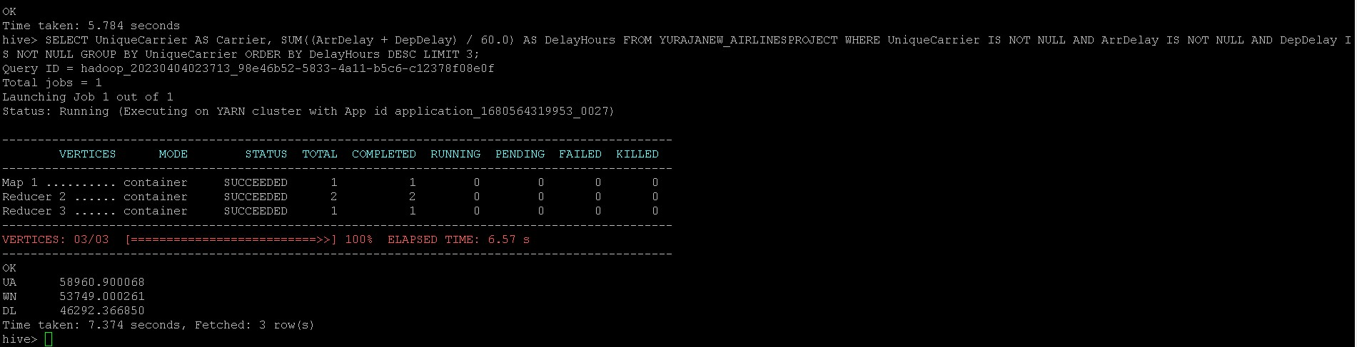
QUERY TO determine the three carriers with the highest delay time (in hours)
Yuraja Kadari -Year Assigned 1998​​
Query: SELECT UniqueCarrier AS Carrier, SUM((ArrDelay + DepDelay) / 60.0) AS DelayHours FROM YURAJANEW_AIRLINESPROJECT WHERE UniqueCarrier IS NOT NULL AND ArrDelay IS NOT NULL AND DepDelay IS NOT NULL GROUP BY UniqueCarrier ORDER BY DelayHours DESC LIMIT 3;
Query Explaination: The SQL query is selecting the "UniqueCarrier" column from the "YURAJANEW_AIRLINESPROJECT" table and calculating the total delay time (in hours) by adding the "ArrDelay" and "DepDelay" columns for each carrier. It then groups the results by the "UniqueCarrier" column, orders them in descending order of the delay time, and limits the output to the top 3 carriers with the highest delay time.

Slide 11
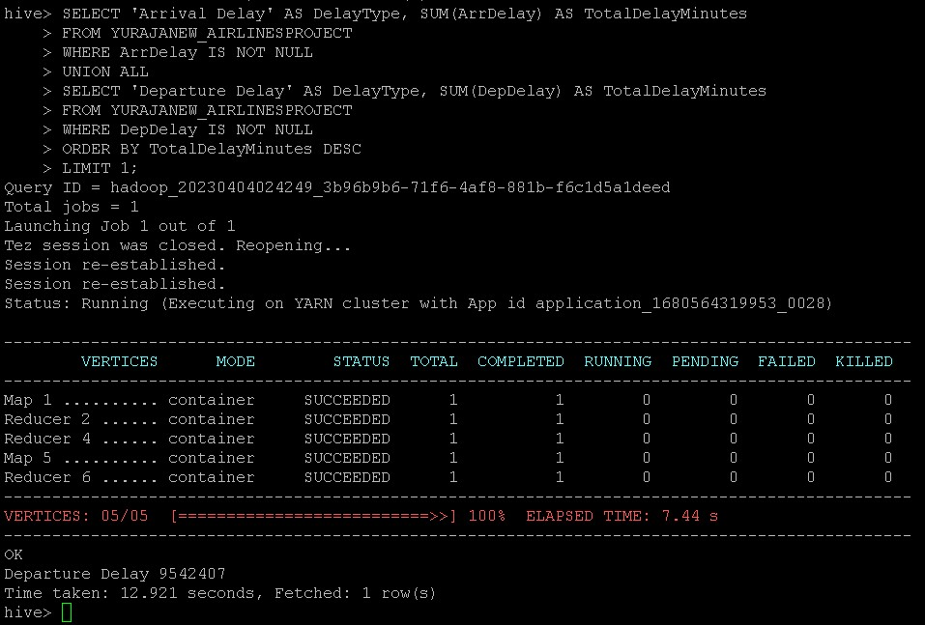
QUERY TO determine overall which type of delay (arrivals or departures) is the largest for airports
Yuraja Kadari -Year Assigned 1998​​
Query: SELECT 'Arrival Delay' AS DelayType, SUM(ArrDelay) AS TotalDelayMinutes FROM YURAJANEW_AIRLINESPROJECT WHERE ArrDelay IS NOT NULL UNION ALL SELECT 'Departure Delay' AS DelayType, SUM(DepDelay) AS TotalDelayMinutes FROM YURAJANEW_AIRLINESPROJECT WHERE DepDelay IS NOT NULL ORDER BY TotalDelayMinutes DESC LIMIT 1;
Query Explaination:The query calculates the total delay time for each type of delay (arrivals and departures) across all carriers by summing the ArrDelay and DepDelay columns, respectively, for all flights where the corresponding delay is not null. The results are then combined using a union operation and labeled with a DelayType column ('Arrival Delay' or 'Departure Delay'). The final result is ordered in descending order by the total delay time and limited to the first row, which represents the delay type with the largest total delay time.

Slide 12
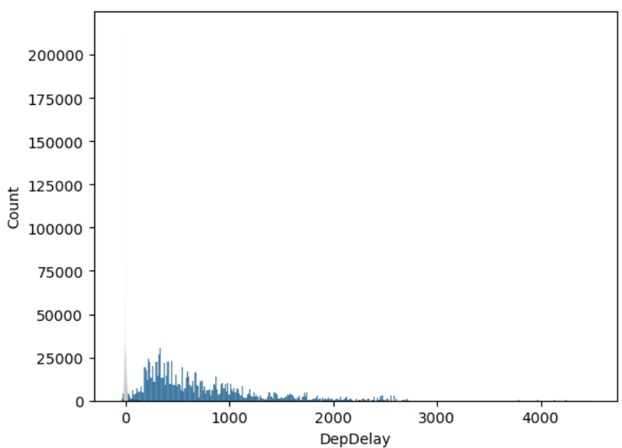
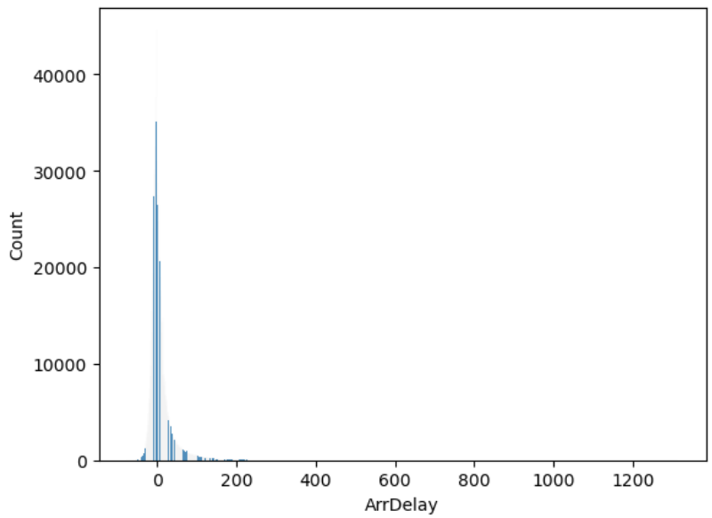
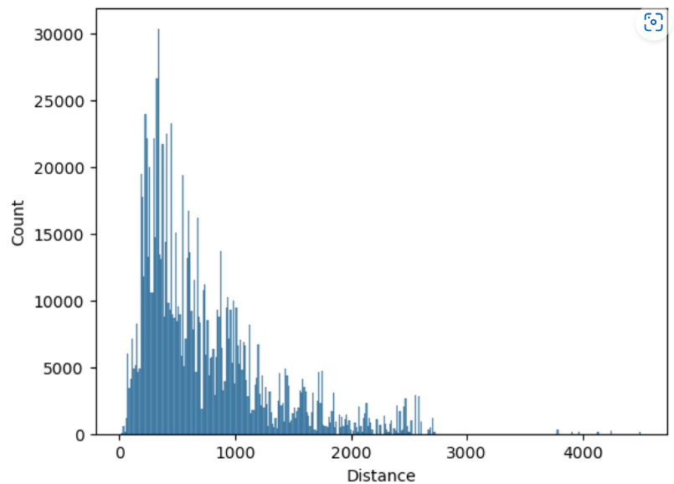
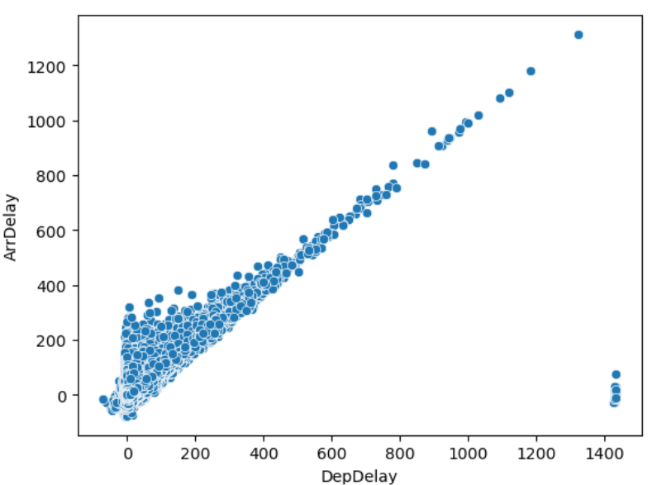
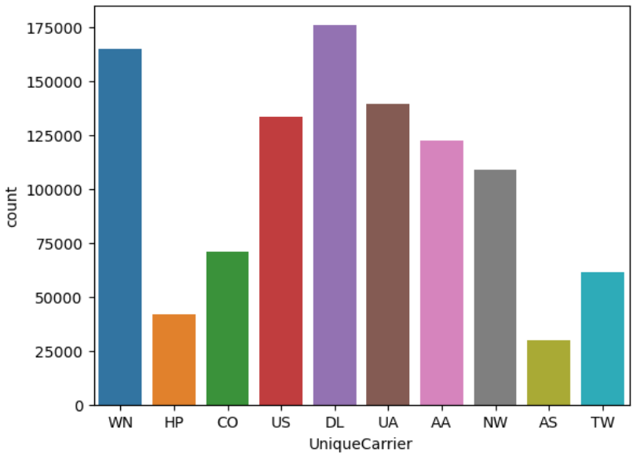
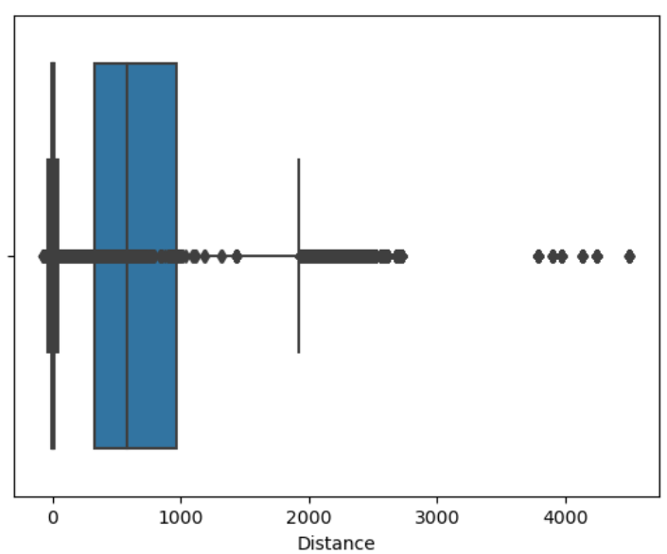
Exploratory Data analysis
Yuraja Kadari -Year Assigned 1998​​
Data Insights using Python:

Slide 13
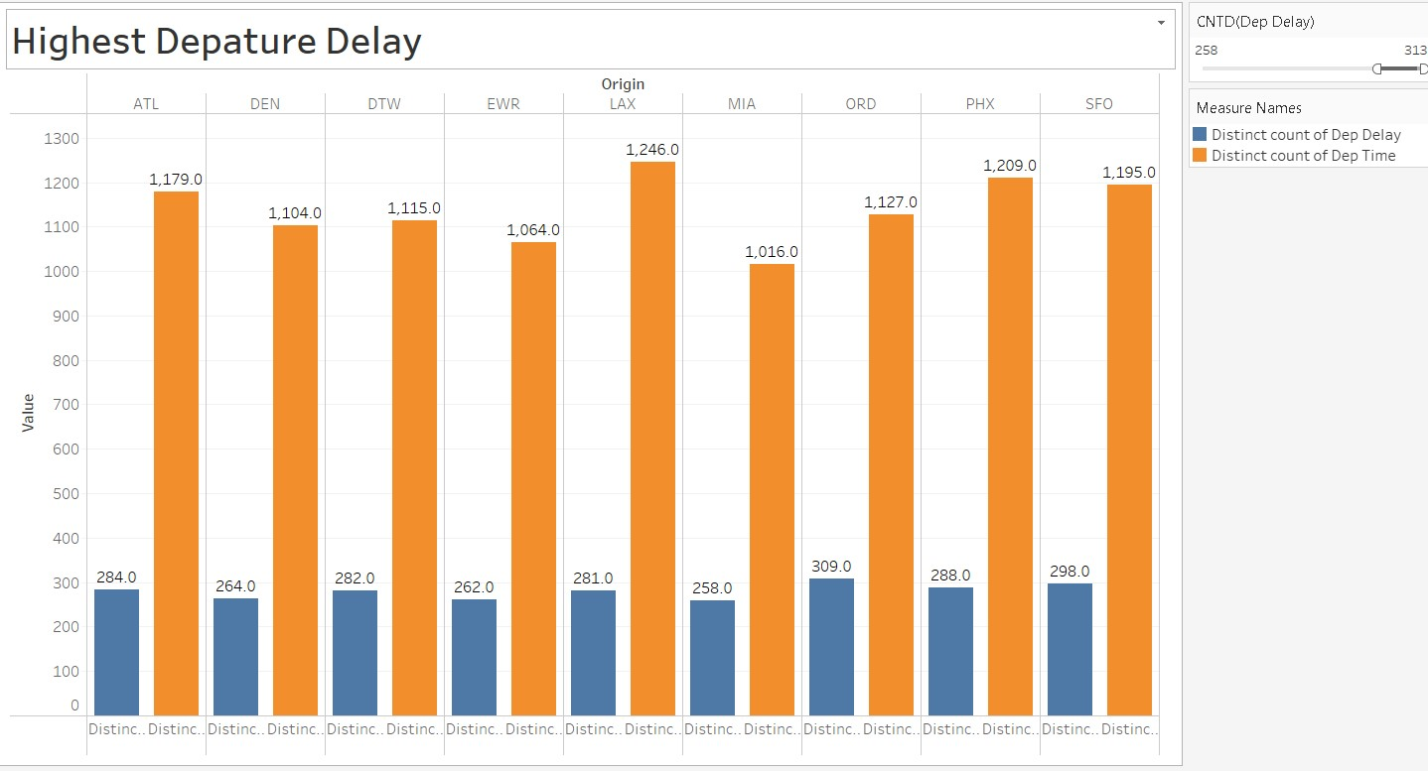
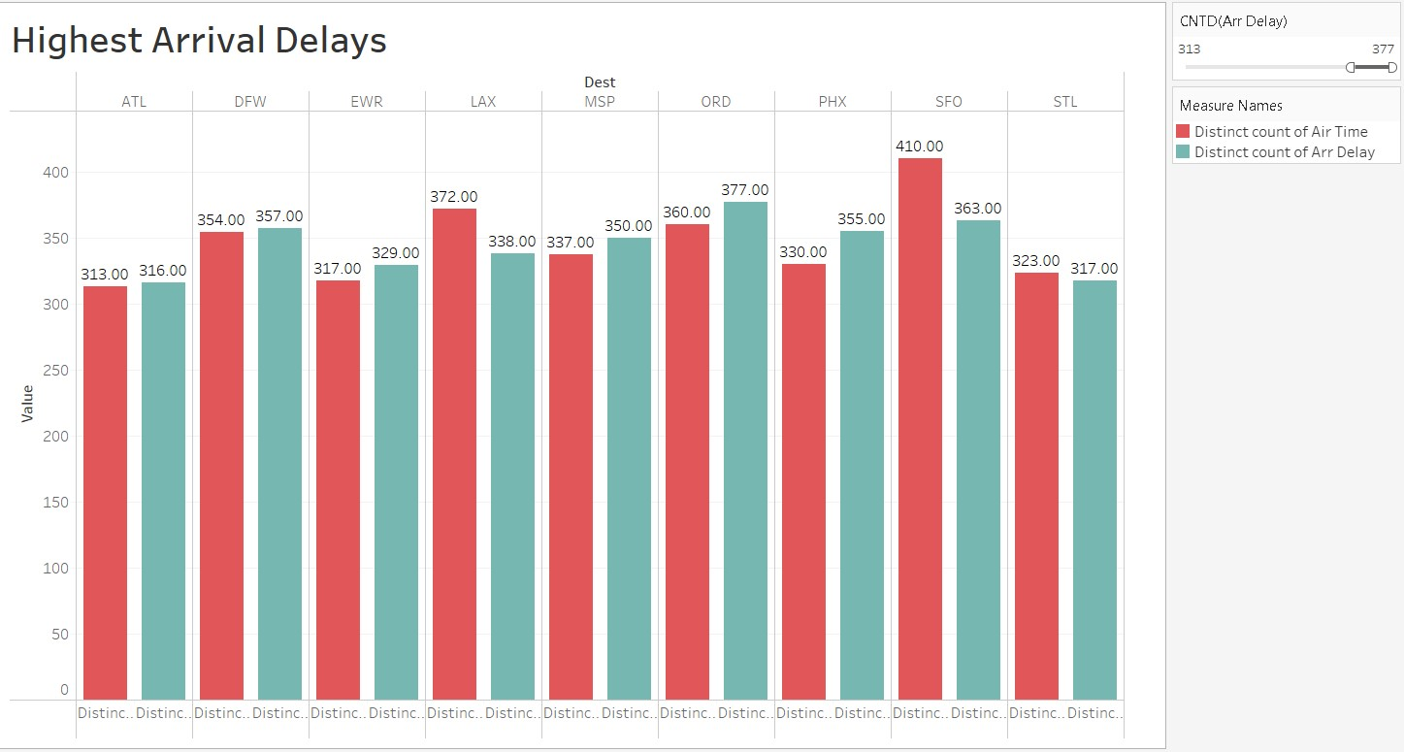
Exploratory Data analysis
Yuraja Kadari -Year Assigned 1998​​
Data Insights using Tableau:

Slide 14
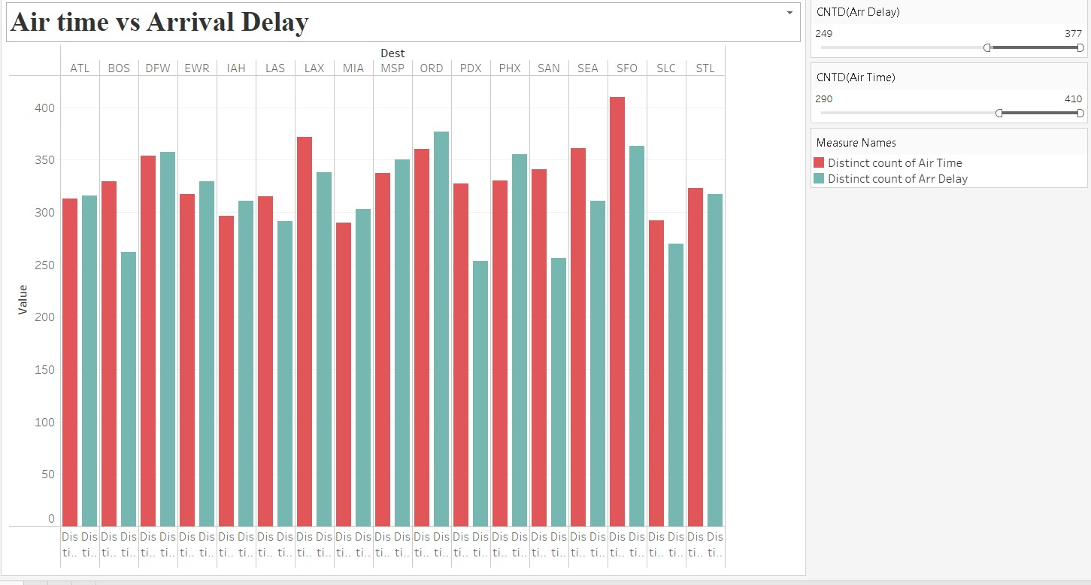
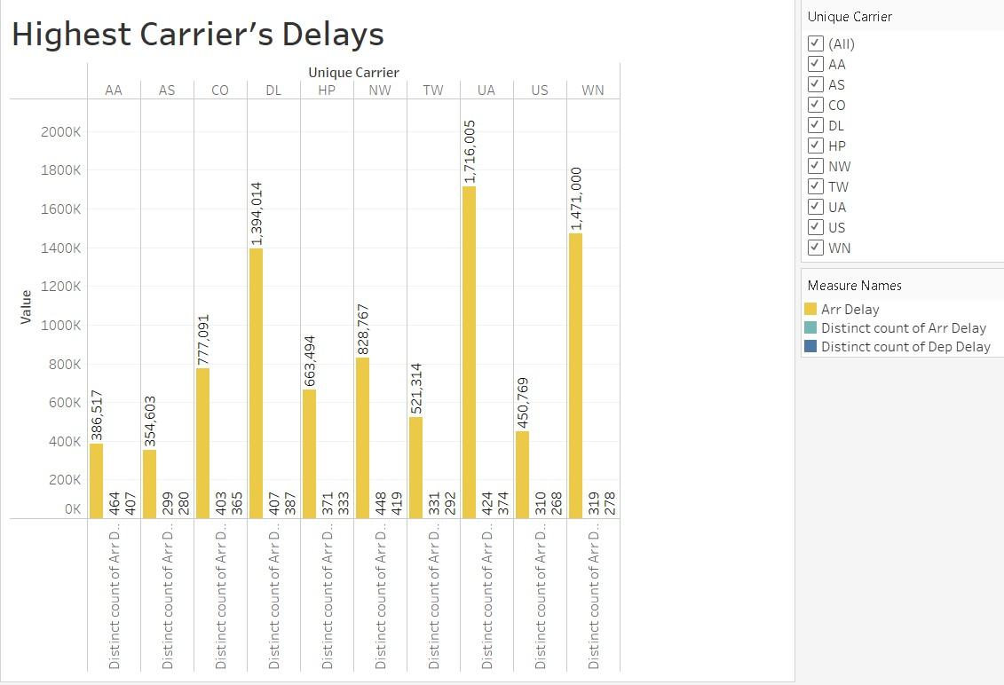
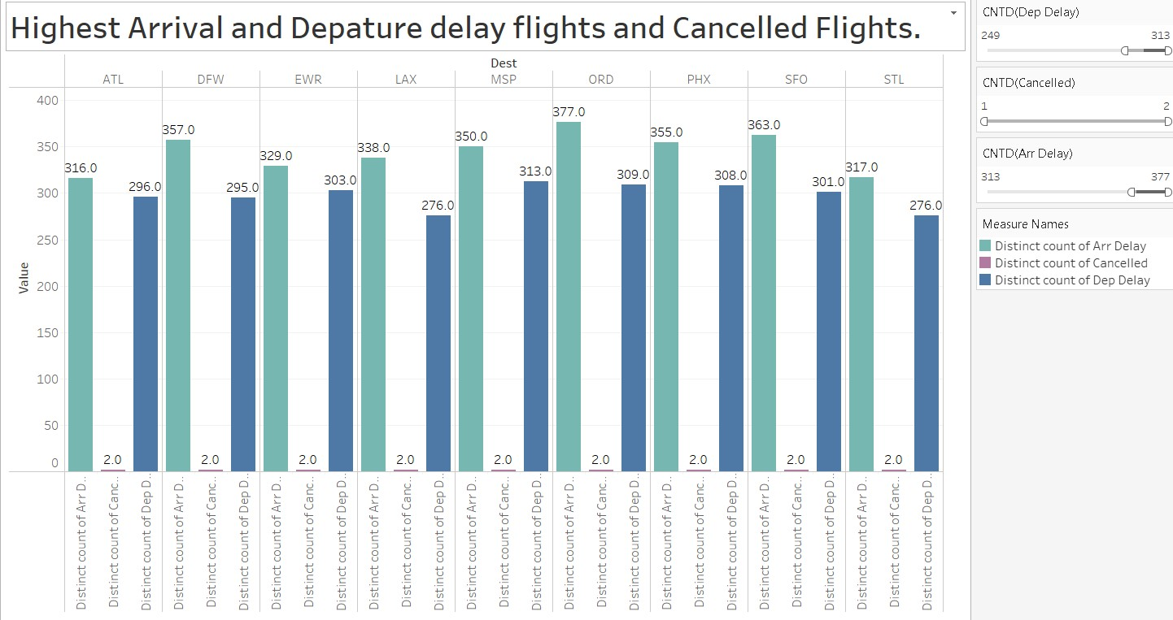
Exploratory Data analysis
Yuraja Kadari -Year Assigned 1998​​
Data Insights using Tableau:

Slide 15
Shreeya Desai -
Year Assigned 1997

Slide 16
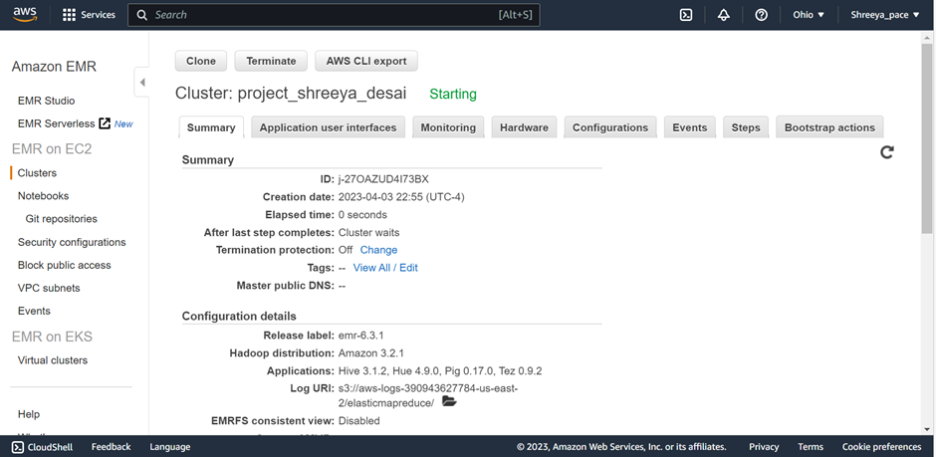
Creation of cluster

Slide 17
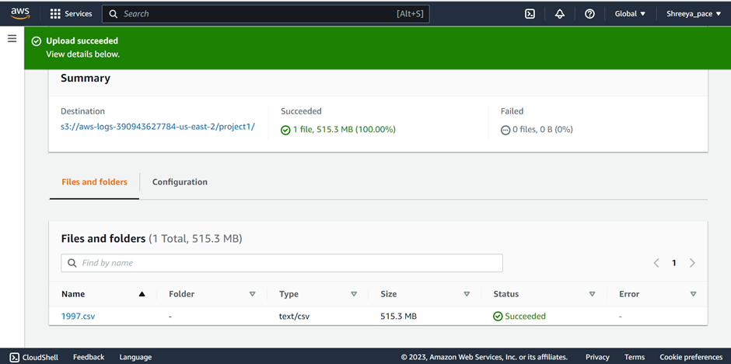
UPLOAD DATA IN AWS S3 BUCKET

Slide 18
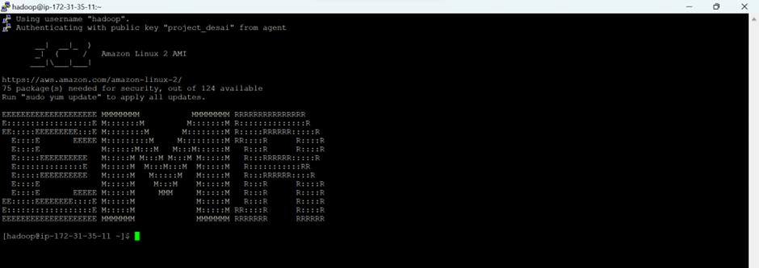
Load EMR using putty

Slide 19
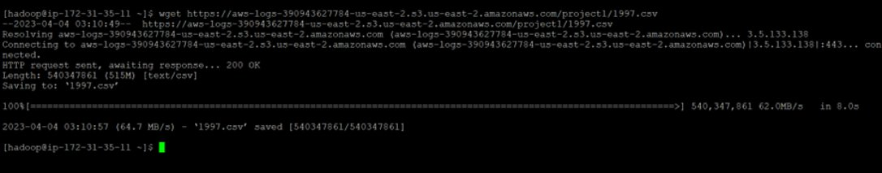
WGET COMMAND

Slide 20
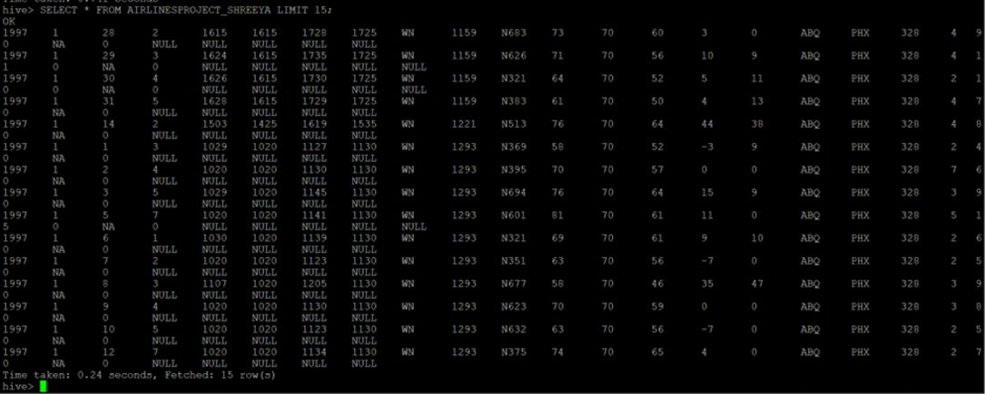
LOAD AND DISPLAY TABLE

Slide 21
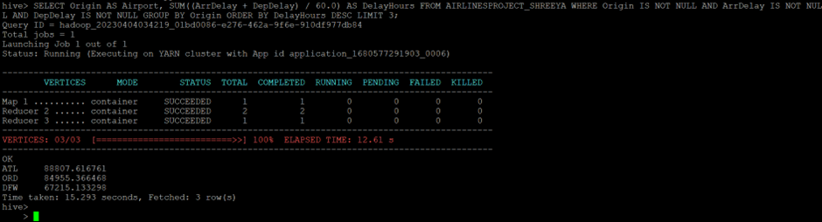
Query to determine the three airports with the highest delay time (in hours)

Slide 22
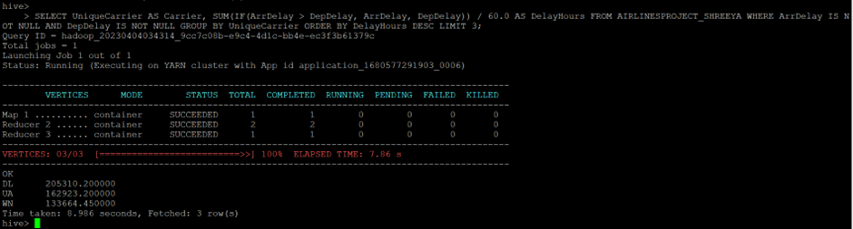
QUERY TO determine the three carriers with the highest delay time (in hours)

Slide 23
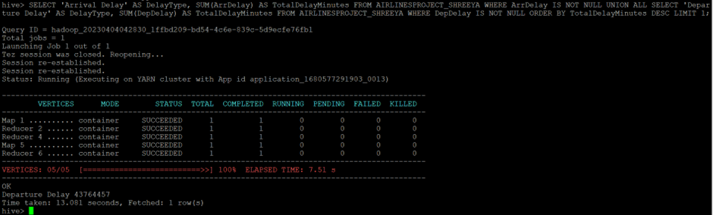
QUERY TO determine overall which type of delay (arrivals or departures) is the largest for airports

Slide 24
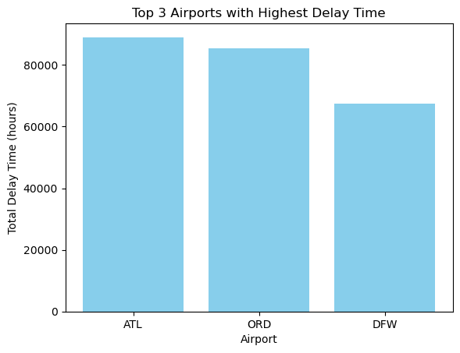
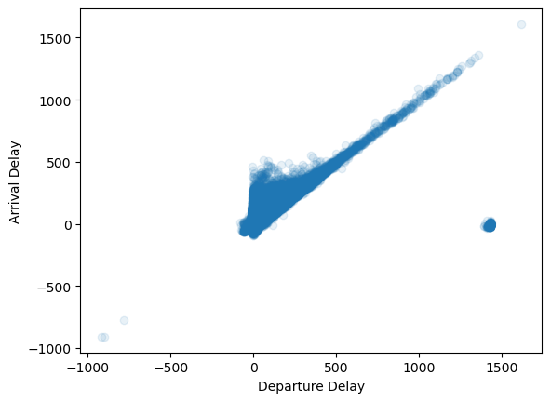
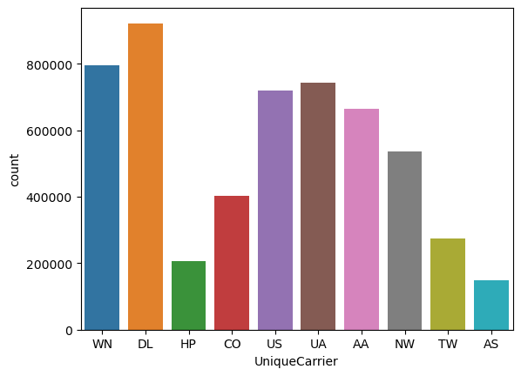
Exploratory Data analysis

Slide 25
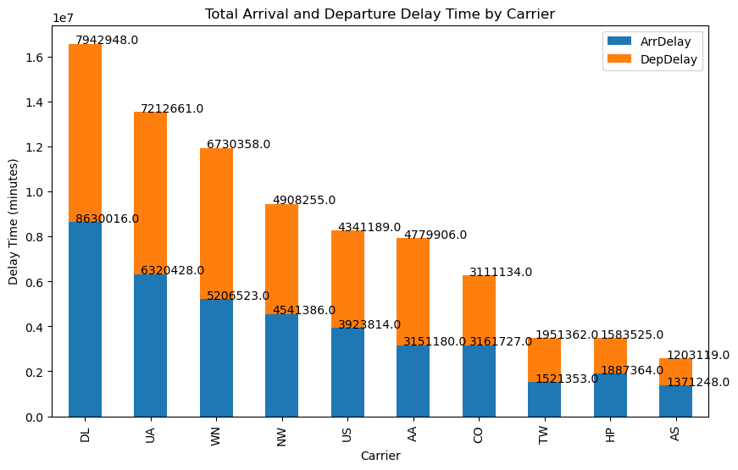
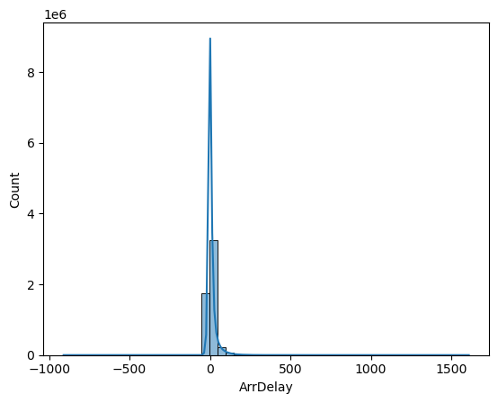
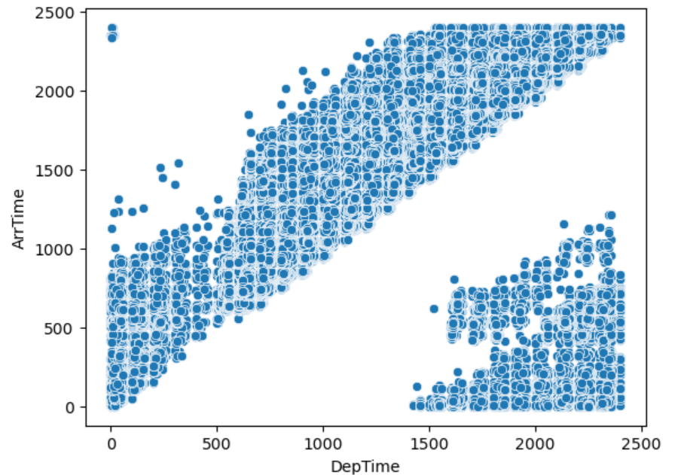
Exploratory Data analysis

Slide 26
Umair Abdul Raheem-
Year Assigned 1999

Slide 27
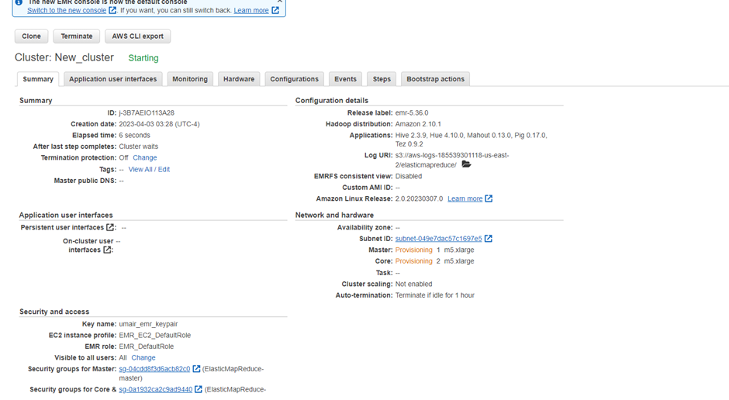
Creation of cluster

Slide 28
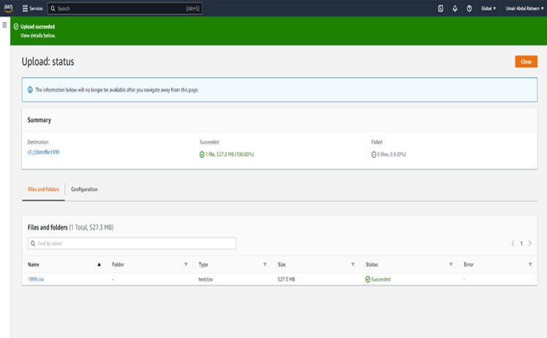
UPLOAD DATA IN AWS S3 BUCKET

Slide 29
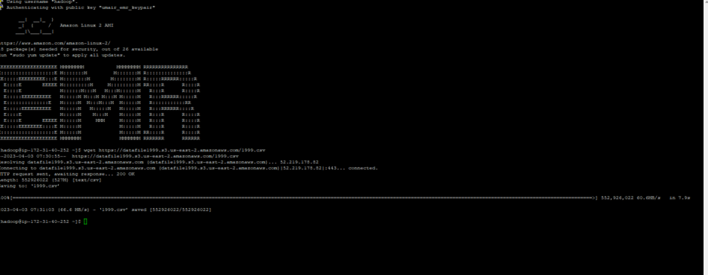
Load EMR using putty

Slide 30
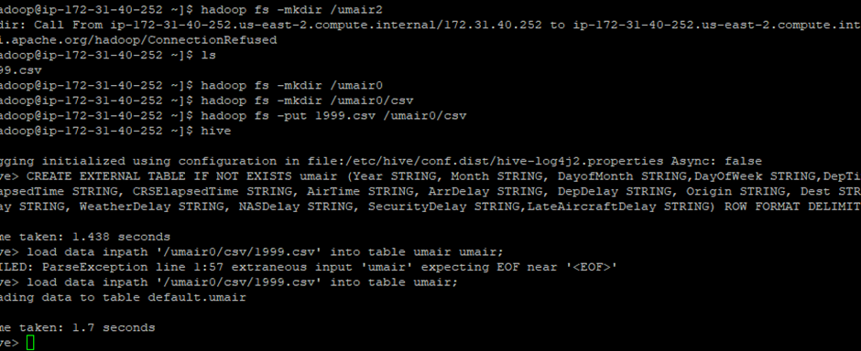
CREATE TABLE

Slide 31
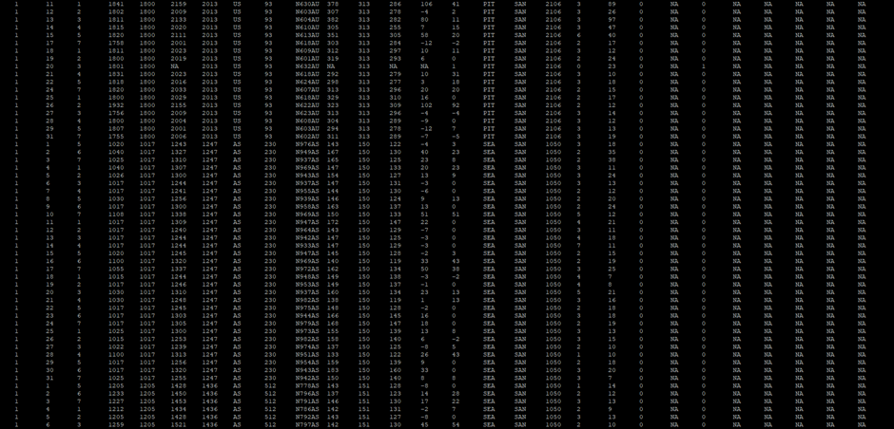
DISPLAY TABLE

Slide 32
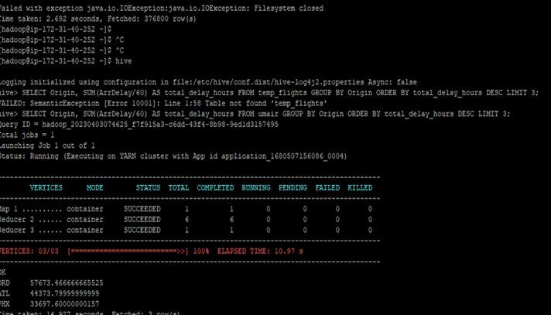
Query to determine the three airports with the highest delay time (in hours)

Slide 33
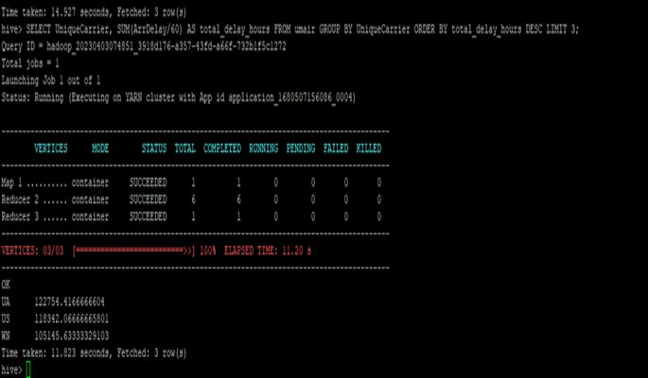
QUERY TO determine the three carriers with the highest delay time (in hours)

Slide 34
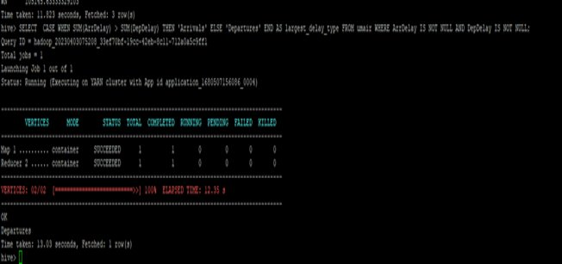
QUERY TO determine overall which type of delay (arrivals or departures) is the largest for airports

Slide 35
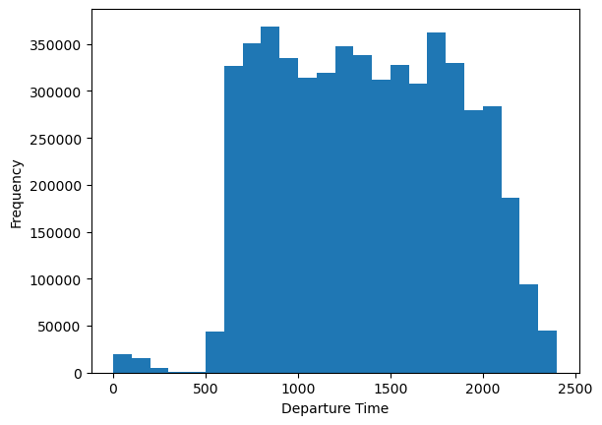
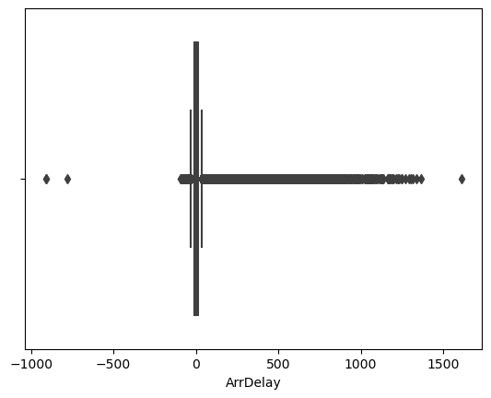
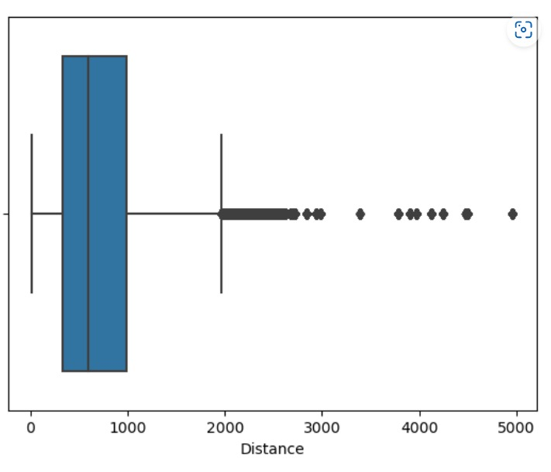
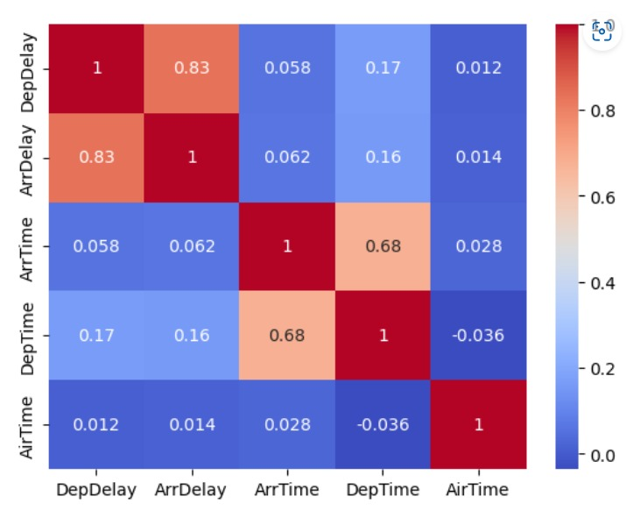
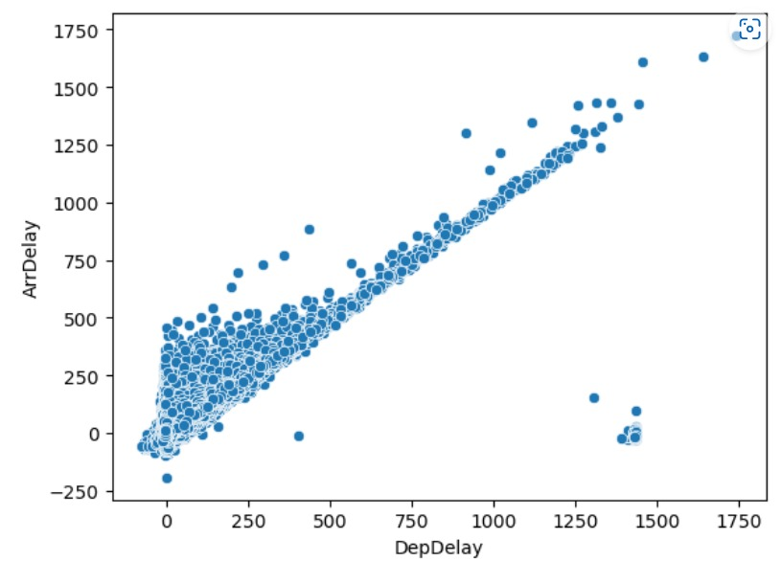
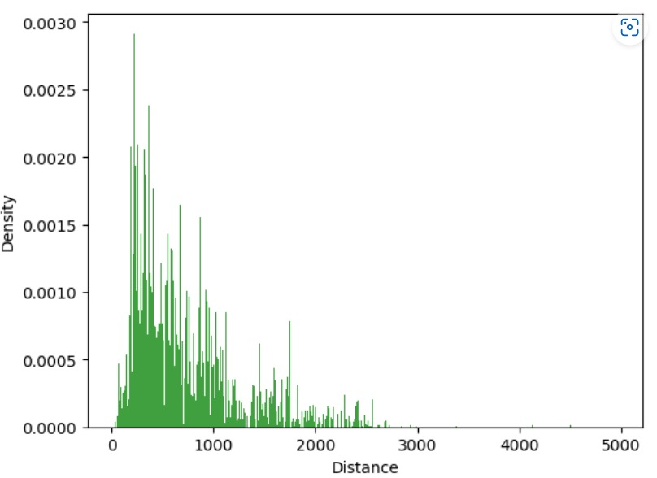
Exploratory Data analysis

Slide 36


Exploratory Data analysis

Slide 37
Vedant Mandre-
Year Assigned 2000

Slide 38

Creating IAM user on grant access to AWS resources

Slide 39

Adding File to S3 Bucket Using WINSCP

Slide 40
Load EMR using putty

Slide 41

CREATE TABLE

Slide 42

DISPLAY TABLE

Slide 43

Query to determine the three airports with the highest delay time (in hours)

Slide 44

QUERY TO determine the three carriers with the highest delay time (in hours)

Slide 45



Exploratory Data analysis

Slide 46






Slide 47






Slide 48
SUMMARY
Chicago O'Hare International Airport had the highest departure delay from 1997 to 2000.
Alaska Airlines had the lowest carrier delay in the year 1999, while DL had the highest overall carrier delay from 1997 to 2000.
ORD had the highest departure delay in the year 1998.
Hawaiian Pacific Airlines had the lowest overall carrier delay from 1997 to 2000.
Flights with higher airtime tend to have more delays.

Slide 49

THANK YOU

